Slide 1
BODY TALK

Slide 2
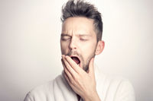
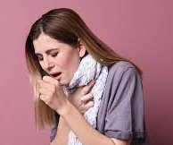
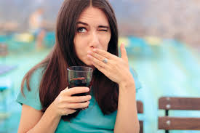

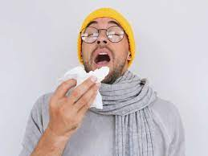
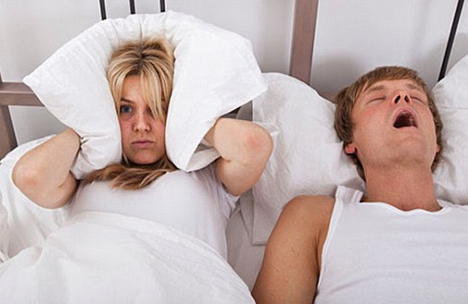
MATCH THE WORDS WITH THE PICTURES
A B
C
D E
F
suddenly take in your breath and then blow it down your nose noisily without being able to stop yourself
open your mouth very wide and breathe in more air than usual
when your face becomes redder than usual because you are ashamed or embarrassed
when someone who is asleep makes a loud noise each time they breathe
force air out of your throat with a sudden, harsh noise, especially when you are ill
make repeated sharp sounds in your throat, often because you have been eating or drinking too quickly
yawn
sneeze
snore
blush
hiccup
cough

Slide 3
MATCH THE WORDS WITH THEIR TRANSLATION
stretch
lung
increase
vocal cords
release
flow
jerky
voice box
dust
pollen
irritate
отпускать, выпускать
пыльца
резкий, порывистый
голосовой аппарат
пыль
раздражать
поток
увеличивать
голосовые связки
легкое
потягиваться

Slide 4
LEARN THE WORDS FOR DICTATION
yawn
sneeze
snore
blush
hiccup
cough
open your mouth very wide and breathe in more air than usual
suddenly take in your breath and then blow it down your nose noisily without being able to stop yourself
when someone who is asleep makes a loud noise each time they breathe
when your face becomes redder than usual because you are ashamed or embarrassed
make repeated sharp sounds in your throat, often because you have been eating or drinking too quickly
force air out of your throat with a sudden, harsh noise, especially when you are ill

Slide 5
LEARN THE WORDS FOR DICTATION
stretch
lung
increase
vocal cords
release
flow
jerky
voice box
dust
pollen
irritate
потягиваться
легкое
увеличивать
голосовые связки
отпускать, выпускать
поток
резкий, порывистый
голосовой аппарат
пыль
пыльца
раздражать

